Slide 1
Growth Analysis Report
Business Performance Analysis & Strategic Insights
Generated on December 03, 2025 | Data Period: Jan 2024

Slide 2
Executive Summary
Comprehensive analysis of 3 key performance indicators reveals significant business insights with both growth opportunities and operational challenges. Strategic focus on high-performing areas combined with targeted improvement initiatives for underperforming segments will drive enhanced business results.

Slide 3
Key Performance Indicators
Rainfall Mm Gro...
-29.7%
Totalal Rainfal...
44
Average Rainfal...
1.5

Slide 4
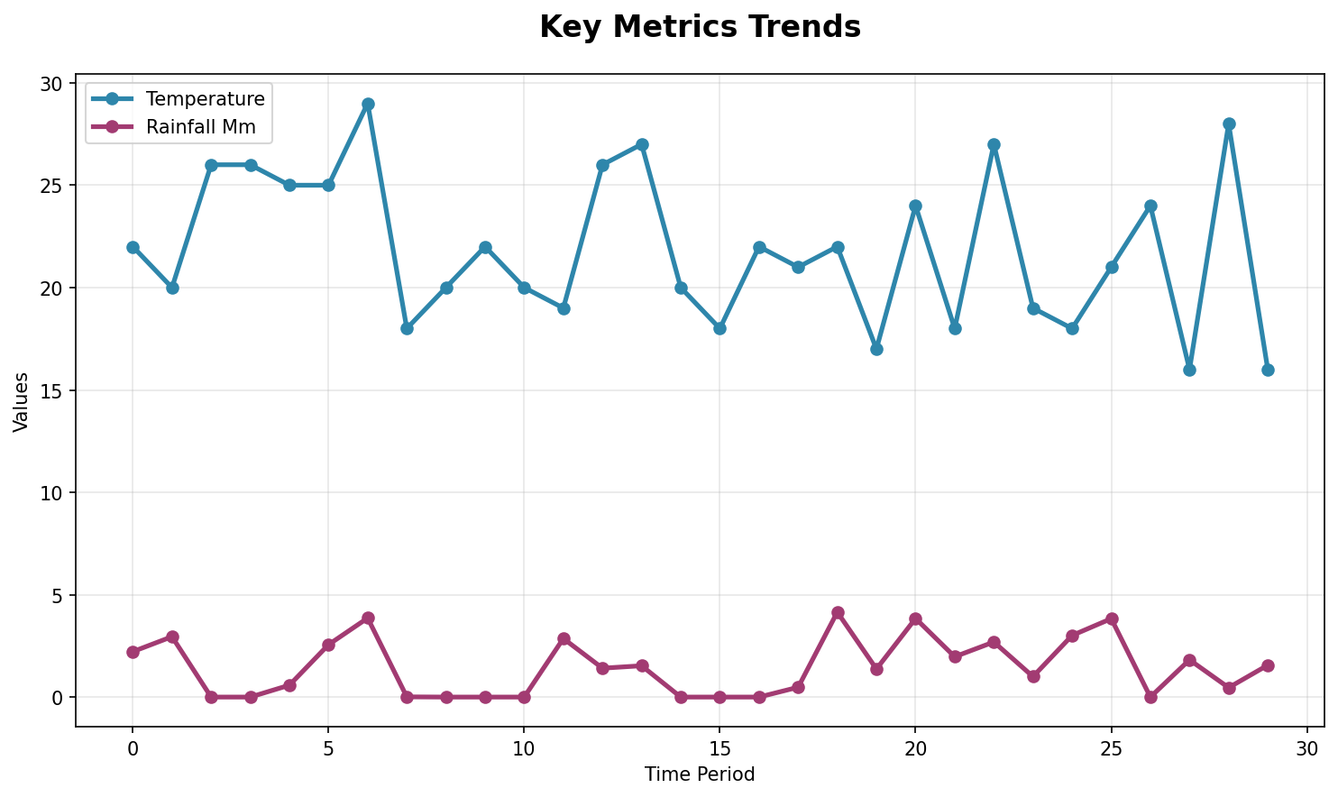
Performance Trends Analysis
Trend analysis showing performance patterns over time with key inflection points highlighted.

Slide 5
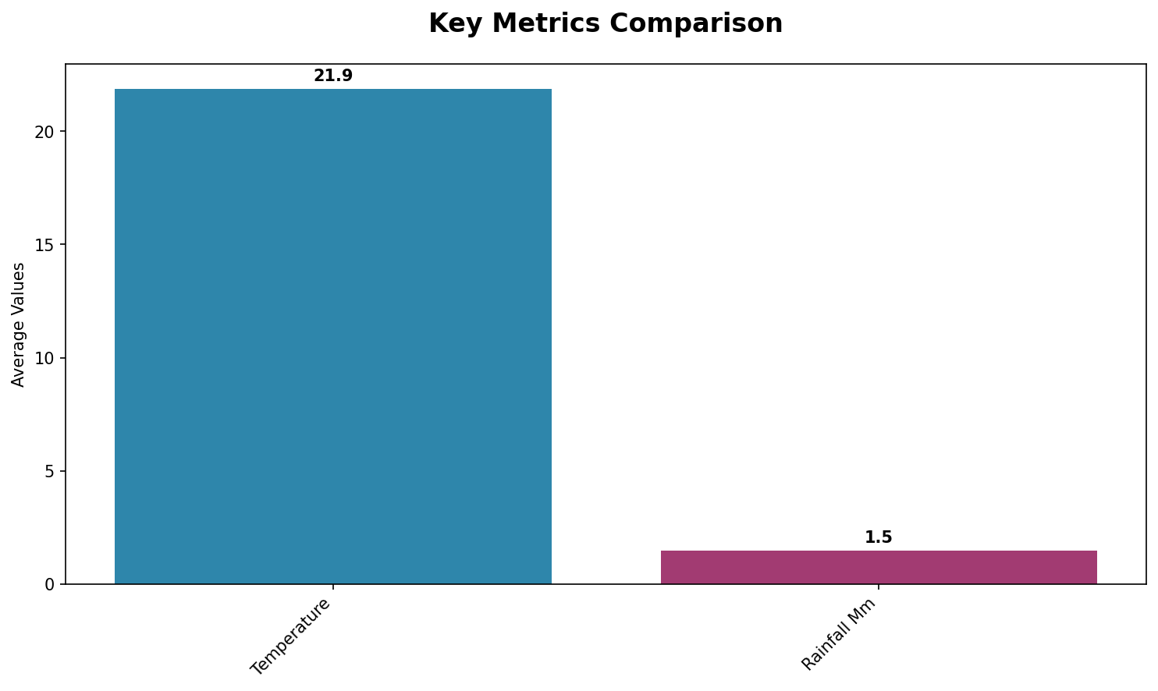
Key Metrics Dashboard
Comprehensive metrics overview displaying relationships between key performance indicators.

Slide 6
Key Insights & Recommendations
Key Business Insights:
• Current total rainfall mm stands at 44, representing a significant business metric that impacts overall performance.
• Declining rainfall mm growth rate at -29.7% requires immediate attention to prevent further performance deterioration.
Strategic Recommendations:
• Implement comprehensive performance monitoring systems to track key business indicators in real-time.
• Develop targeted strategies to capitalize on high-performing areas while addressing underperforming segments.
• Establish regular review cycles to assess progress against business objectives and adjust tactics accordingly.

Slide 7
Next Steps & Action Items
Key Action Items for Next Quarter:
• Implement comprehensive performance monitoring systems to track key business indicators in real-time.
• Develop targeted strategies to capitalize on high-performing areas while addressing underperforming segments.
• Establish regular review cycles to assess progress against business objectives and adjust tactics accordingly.

